Slide 1

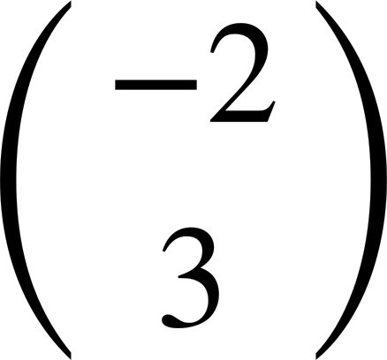
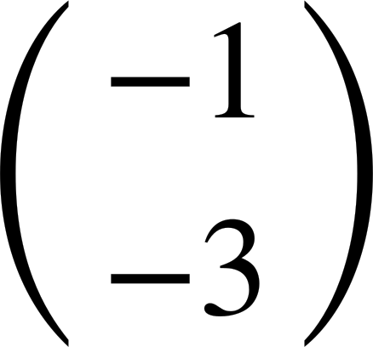
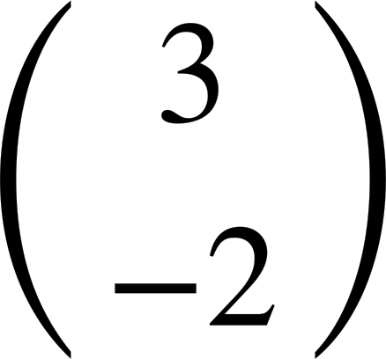
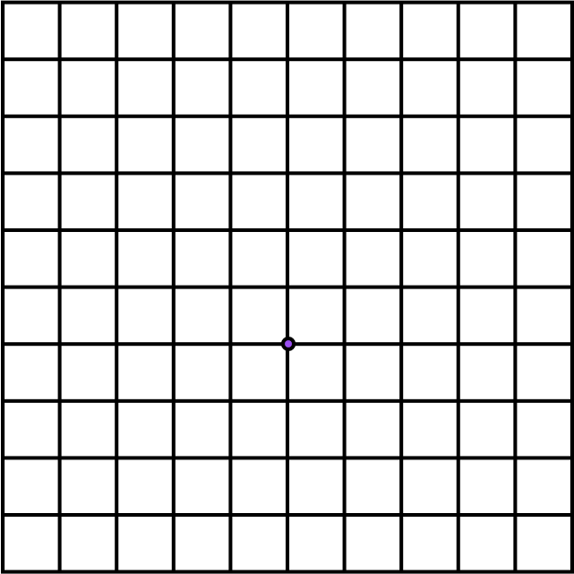
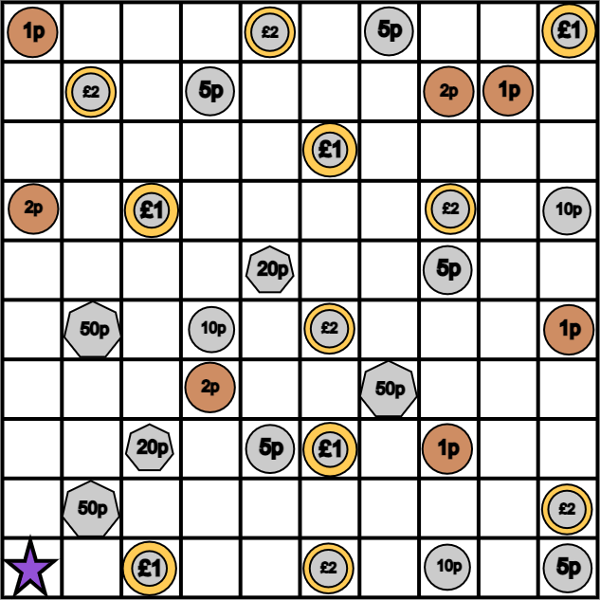

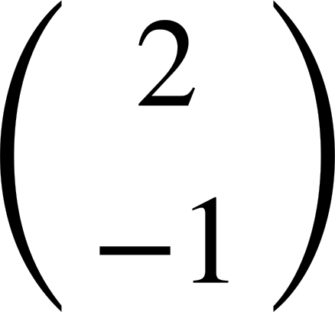
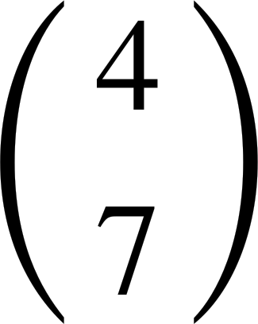
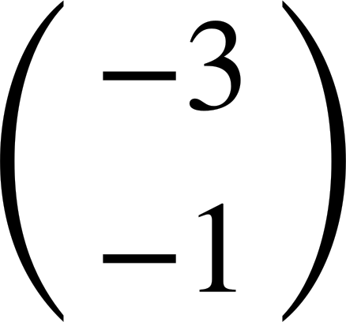
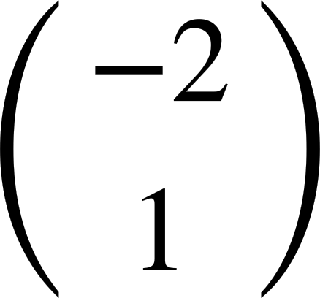

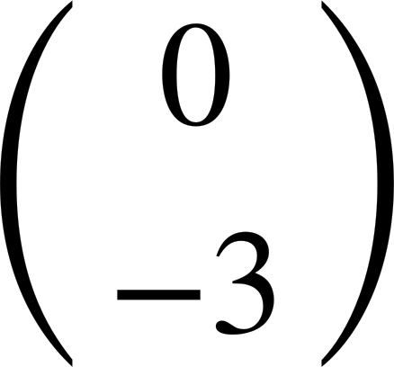
Translating objects
Task A: Translating a single point from a description
Mark the image of point L after the following translations:
.
b)
c)
d)
b
x
x
a
L
c
x
d
x
Work out the total money collected when following this vector trail. Start on the star.
.
£1.33
Investigate the total money you can collect using all of the vectors but in any order. Start on the star.
.
0
A=
B=
C=
D=
E=
F=
G=
Some examples:
A-C-F-B-G-E-D £3.36
E-A-D-F-C-G-B 5p

Slide 2
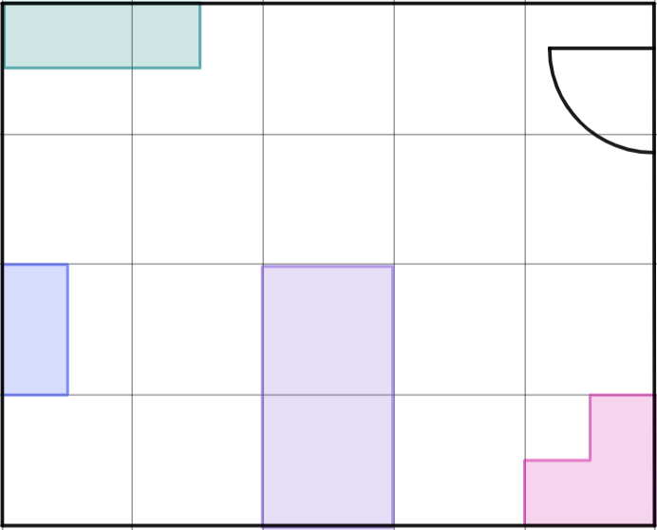

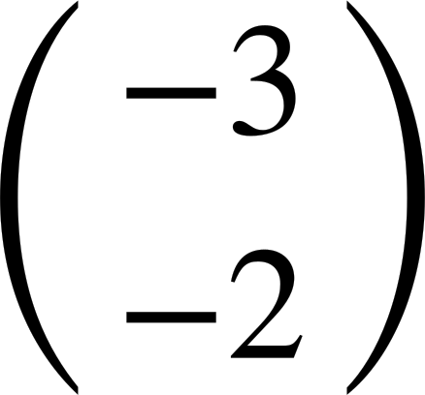
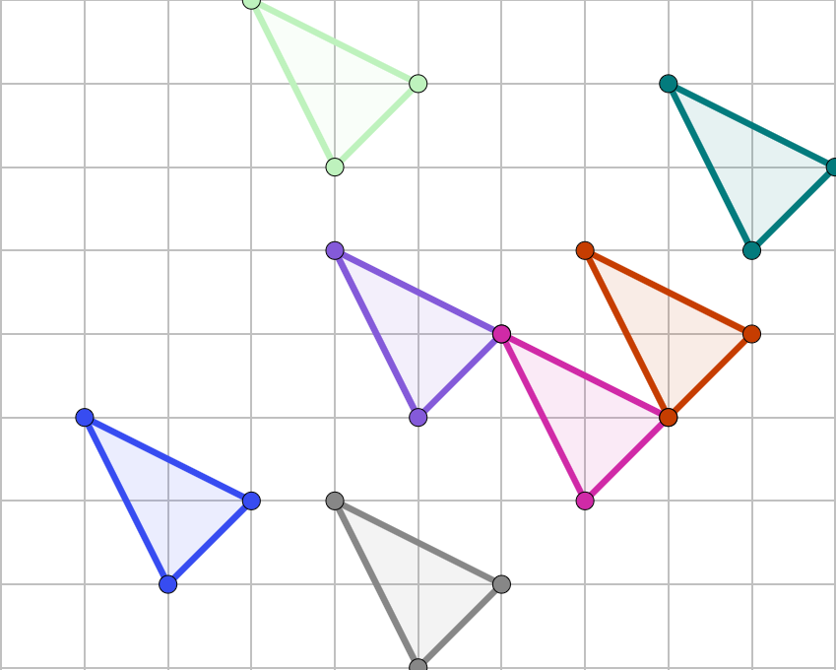
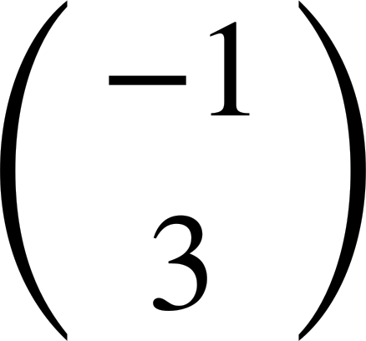

Translating objects
Task B: Translating more complex objects
Here is a plan view of a bedroom. By only translating the objects, redesign the layout.
drawers
Here is an example.
The pink corner wardrobe cannot move anywhere else, if it is to remain touching two walls.
desk
bed
wardrobe
Complete the translations, always start with triangle A.
b)
d
a
c)
d)
f)
A
e
e)
c
b
f
Mathematics in Education and Industry.
v2.2

